Slide 1
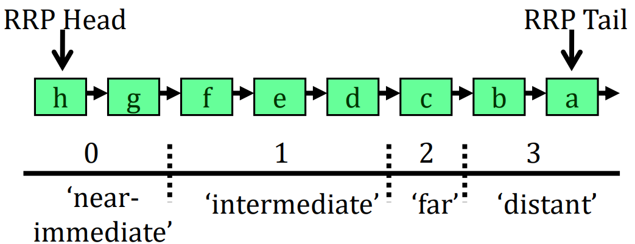
RRIP⁷
Re-reference prediction value (RRPV)
Insert with RRPV = 2, Evict with RRPV = 3
On re-reference Promote with RRPV = 0
Non-temporal data(Scans) should not discard frequently referenced blocks
Static RRIP(Single core)
Thread-Aware Dynamic RRIP(SRRIP + BRRIP, multicore)

Slide 2
DRRIP⁷
Scan resistant SRRIP – Insert with RRPV = 2
Thrash resistant BRRIP – Insert with RRPV = 3
Set dueling mechanism to choose between SRRIP & BRRIP
PACMAN⁸
Modifies DRRIP policy
Insert prefetch blocks with RRPV = 3
No promotion of prefetched blocks on hit

Slide 3
CASPER @ IIT Bombay
RnD Weekly Discussion
Week of November 2, 2021
Sumon Nath sumon@cse.iitb.ac.in

Slide 4
Work done
Analysis of performance degradation in case of low dram bandwidth for different benchmark suites.
Studying the impact of different cache replacement policies with respect to IPCP.

Slide 5
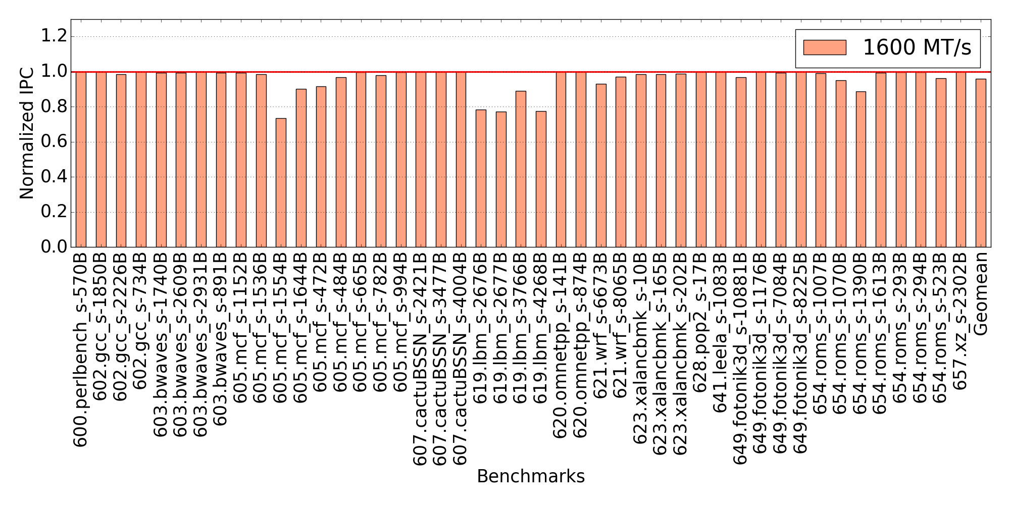
Performance degradation for low DRAM bandwidth [SPECCPU 2017]
Baseline: 6400 MT/s

Slide 6
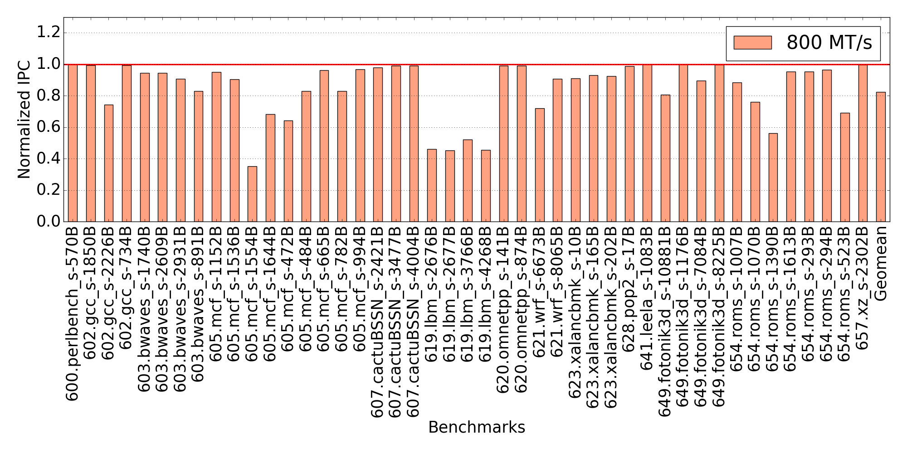
Performance degradation for low DRAM bandwidth [SPECCPU 2017]
Baseline: 6400 MT/s

Slide 7
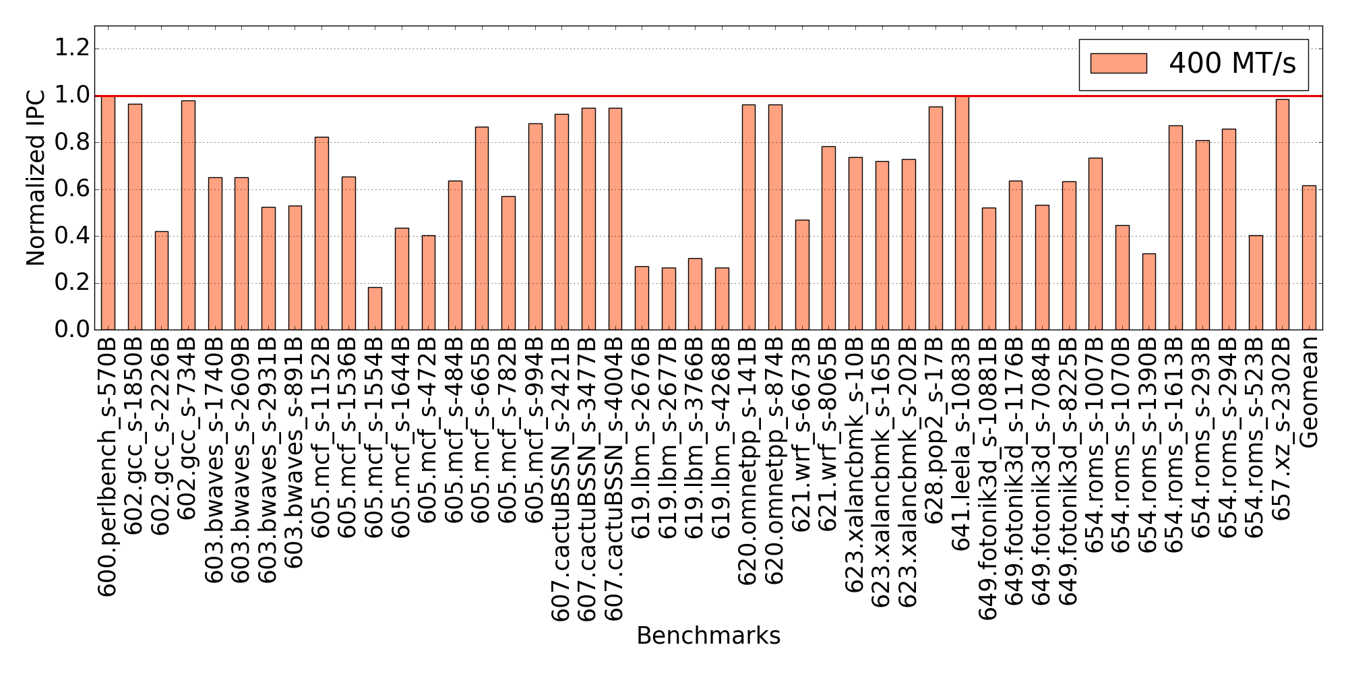
Performance degradation for low DRAM bandwidth [SPECCPU 2017]
Baseline: 6400 MT/s

Slide 8
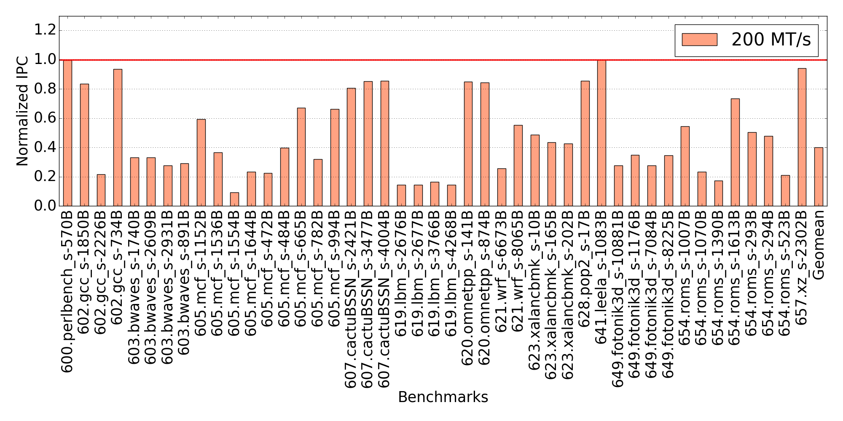
Performance degradation for low DRAM bandwidth [SPECCPU 2017]
Baseline: 6400 MT/s

Slide 9
Performance degradation for low DRAM bandwidth [SPECCPU 2017]
Prefetcher – IPCP
Baseline – 6400 MT/s (DRAM bandwidth)
Large performance hit for low dram bandwidth.
Scope for performance improvement.

Slide 10
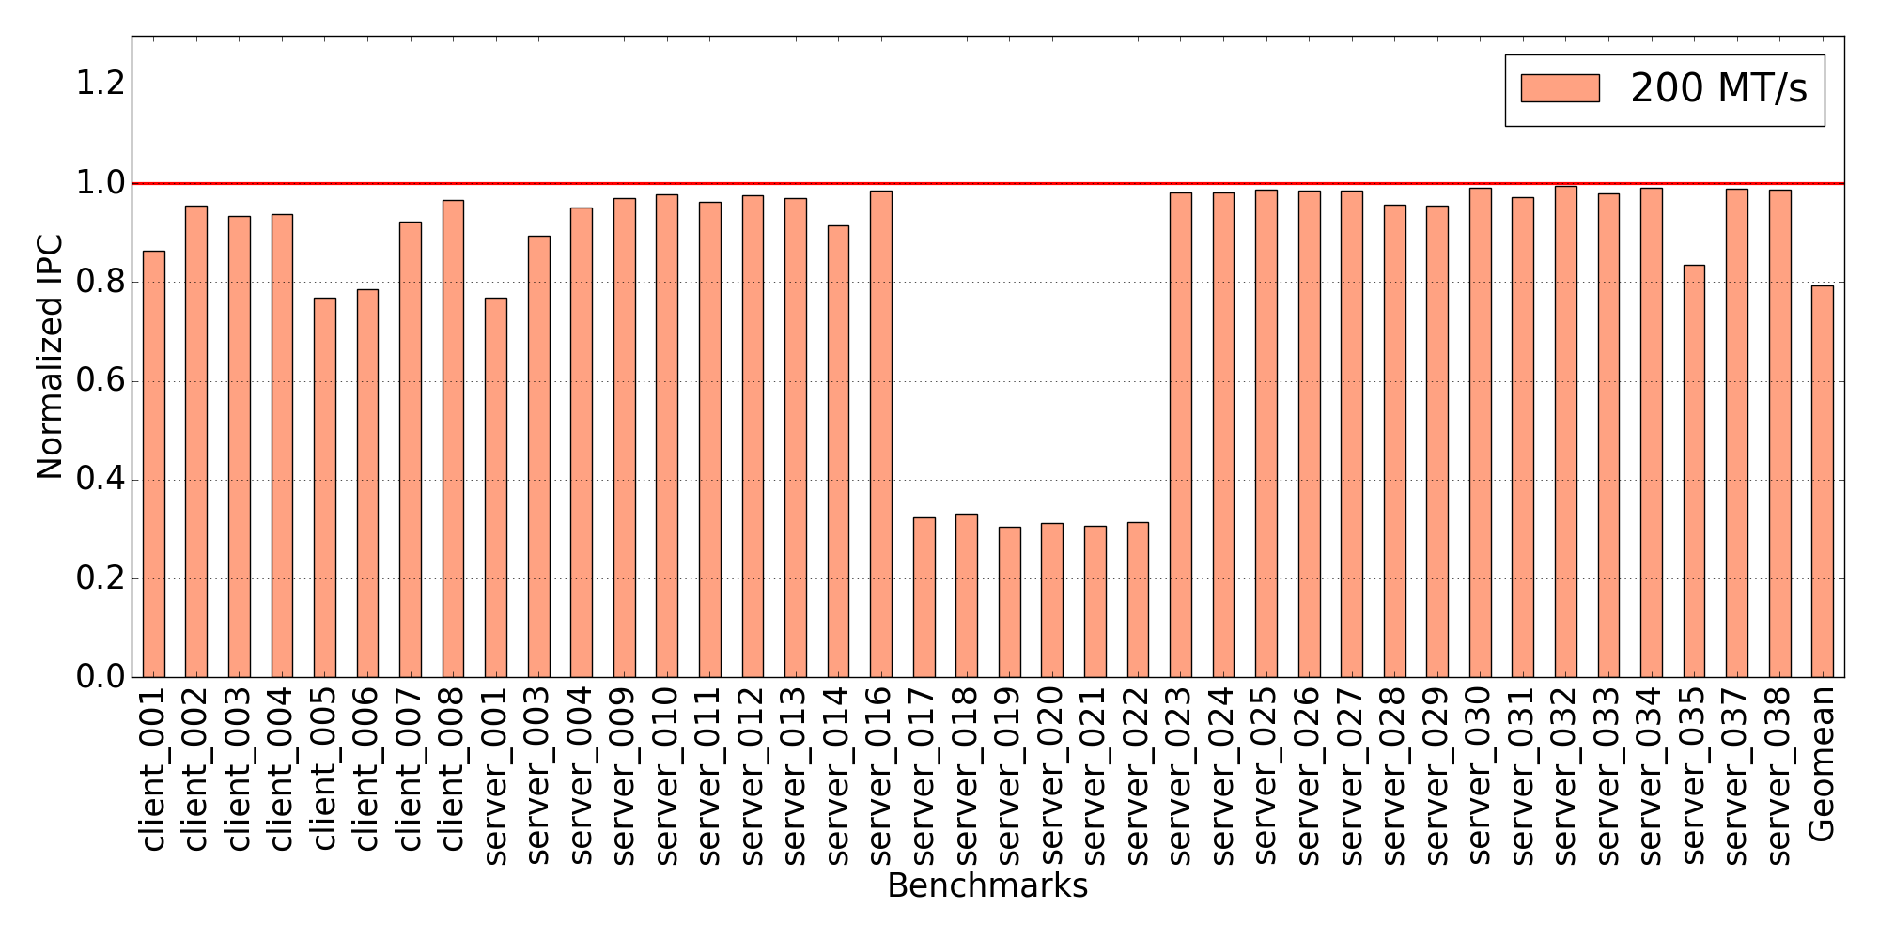
Performance degradation for low DRAM bandwidth [Client-server]
Baseline: 6400 MT/s

Slide 11
Performance degradation for low DRAM bandwidth [Client-server]
Prefetcher – IPCP
Baseline – 6400 MT/s (DRAM bandwidth)
Less performance hit compared to spec benchmarks.

Slide 12
Question
What are the factors leading to performance degradation for low dram bandwidth?

Slide 13
Impact of replacement policy on prefetcher performance

Slide 14
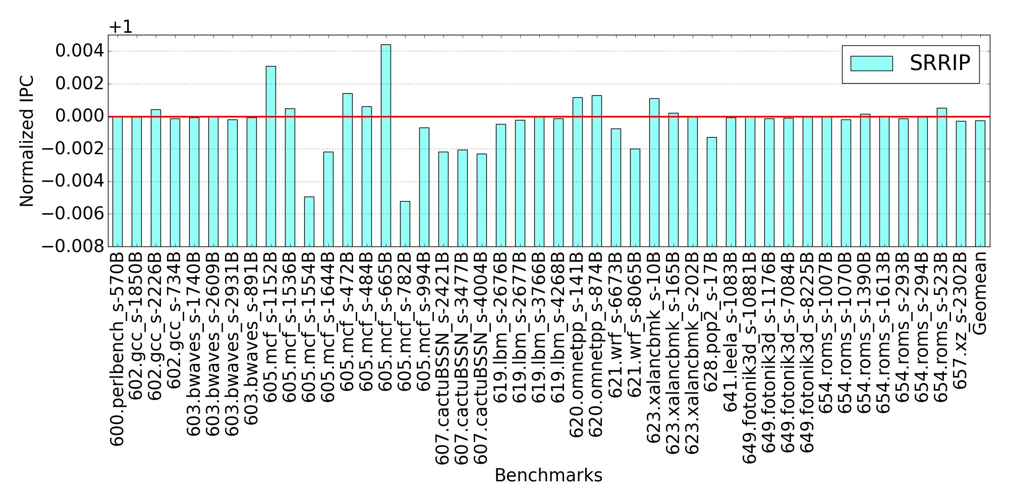
Performance impact with SRRIP[SPEC CPU ‘17]
Prefetcher – IPCP
Baseline – LRU at all levels
SRRIP is used at L1D, L2C
LLC repl. policy - LRU
Insignificant performance impact

Slide 15
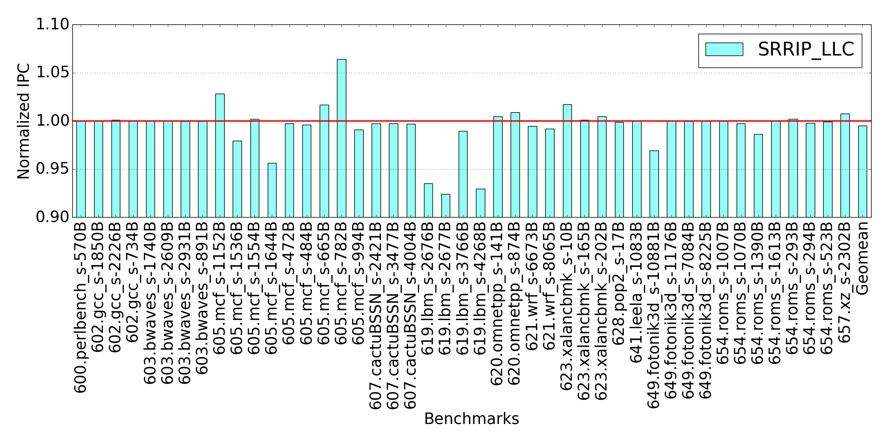
Performance impact with SRRIP[SPEC CPU ‘17]
Prefetcher – IPCP
Baseline – LRU at all levels
SRRIP is used at L1D, L2C and LLC as well
Insignificant performance impact

Slide 16
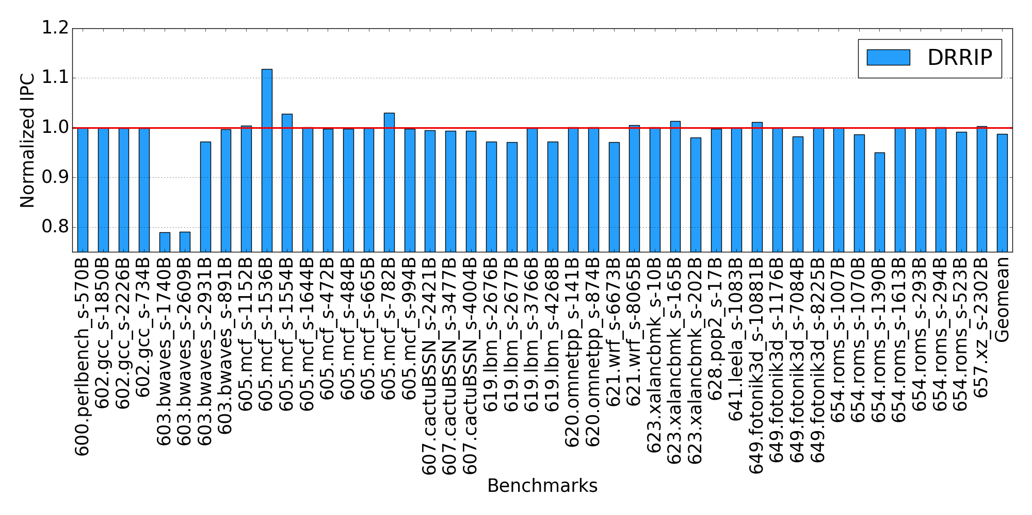
Performance impact with DRRIP[SPEC CPU ‘17]
Prefetcher – IPCP
Baseline – LRU at all levels
DRRIP is used at L1D, L2C
LLC repl. policy - LRU
Insignificant performance impact

Slide 17
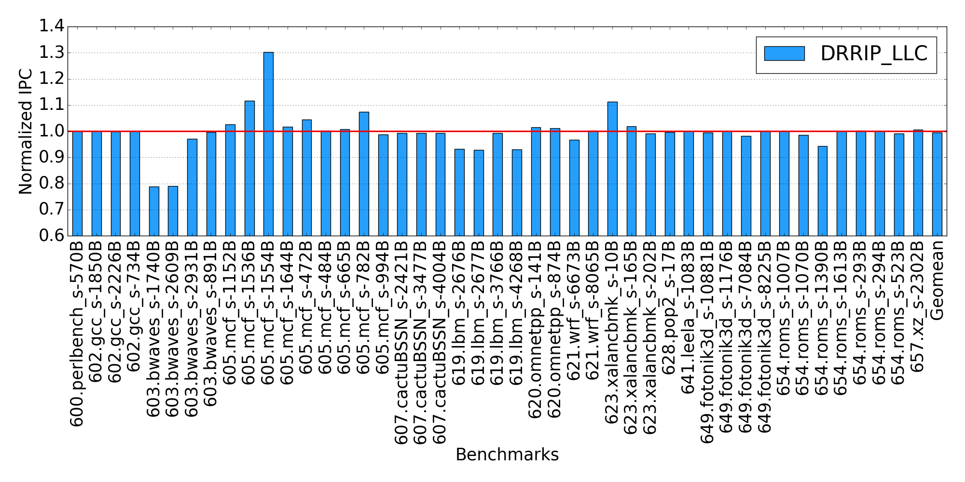
Performance impact with DRRIP[SPEC CPU ‘17]
Prefetcher – IPCP
Baseline – LRU at all levels
DRRIP is used at L1D, L2C and LLC as well

Slide 18
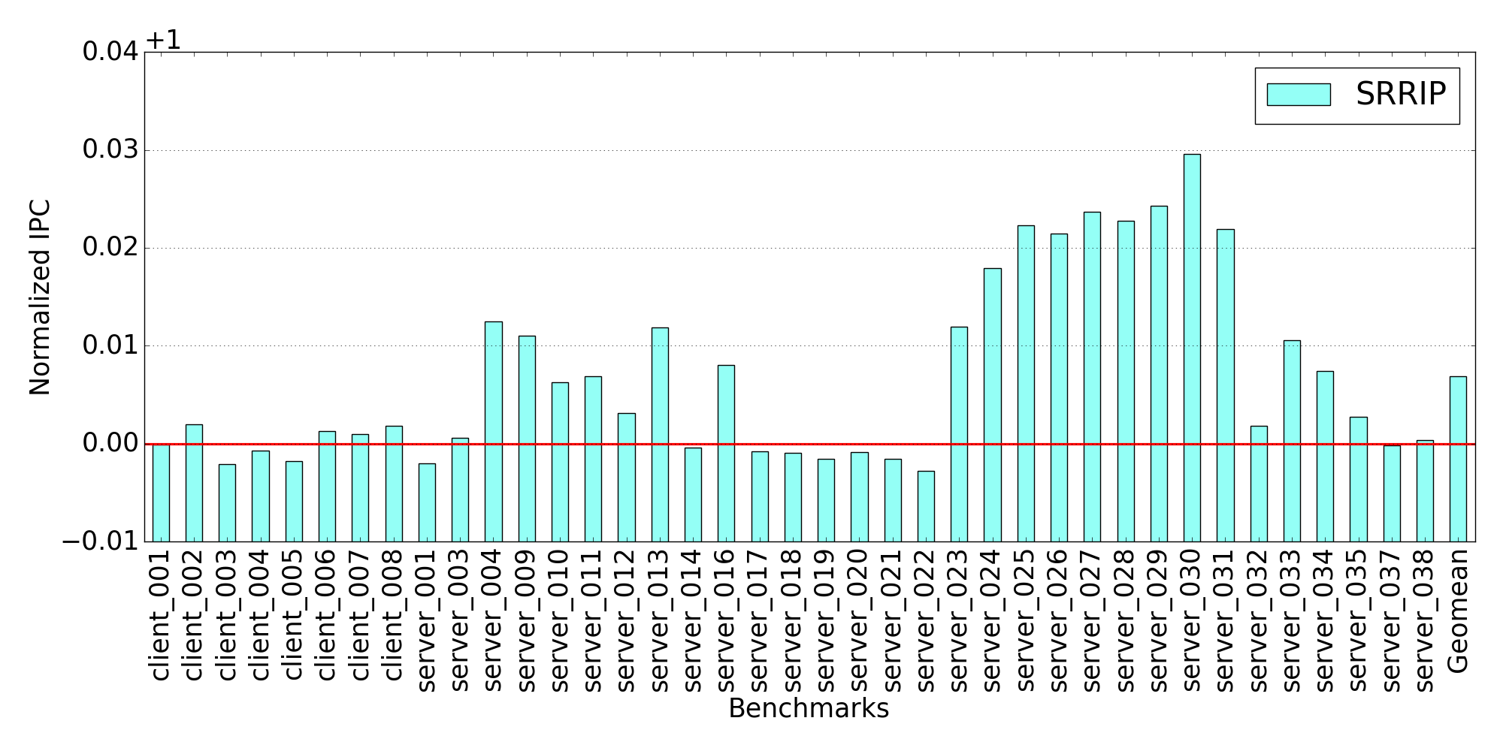
Performance impact with SRRIP[client-server]
Prefetcher – IPCP
Baseline – LRU at all levels
SRRIP is used at L1D, L2C
LLC repl. policy - LRU
Insignificant performance impact

Slide 19
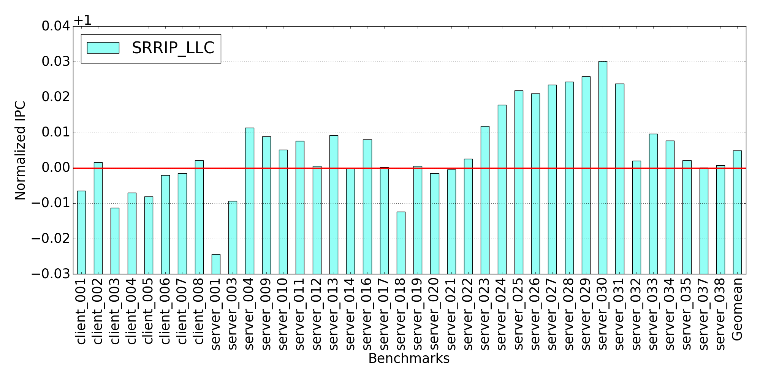
Performance impact with SRRIP[client-server]
Prefetcher – IPCP
Baseline – LRU at all levels
SRRIP is used at L1D, L2C and LLC as well
Insignificant performance impact

Slide 20
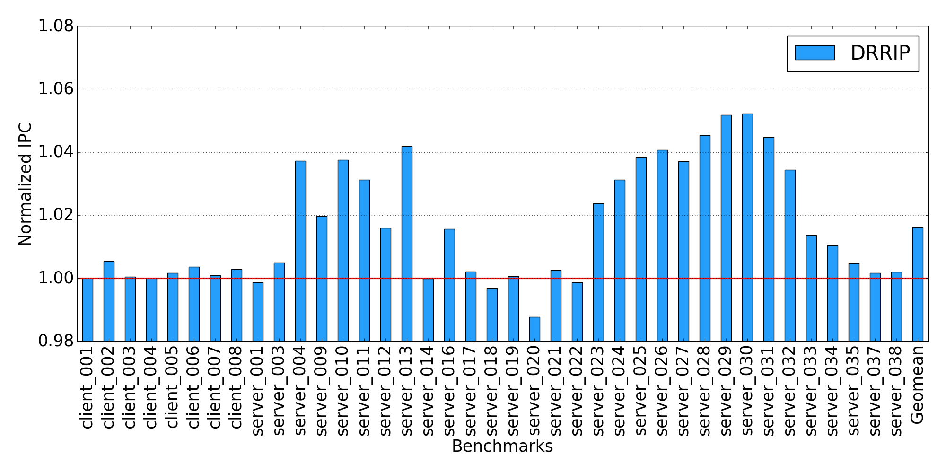
Performance impact with DRRIP[client-server]
Prefetcher – IPCP
Baseline – LRU at all levels
DRRIP is used at L1D, L2C
LLC repl. policy - LRU
Overall marginal performance improvement

Slide 21
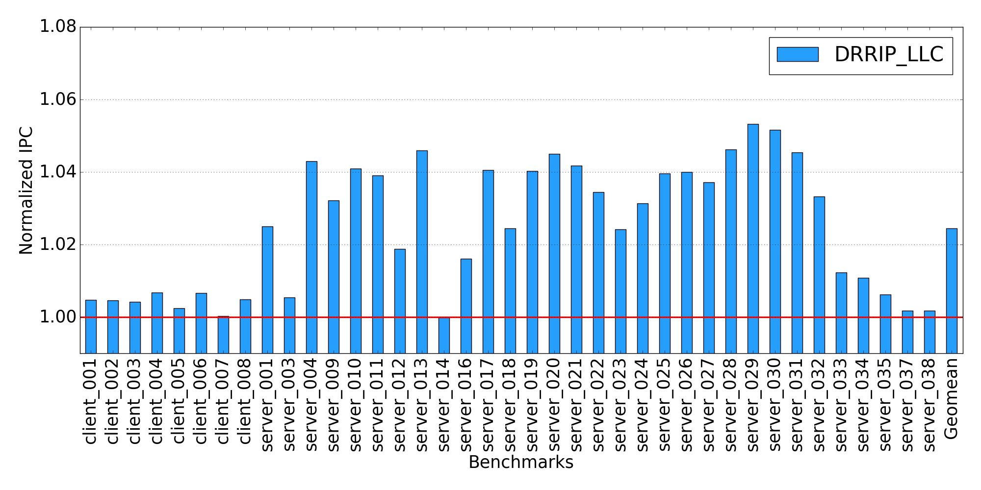
Performance impact with DRRIP[client-server]
Prefetcher – IPCP
Baseline – LRU at all levels
DRRIP is used at L1D, L2C and LLC as well
Overall marginal performance improvement

Slide 22
Takeaway
Marginal performance degradation in case of SPEC CPU 2017 benchmarks both for SRRIP & DRRIP
Marginal performance improvement in case of client-server benchmarks both for SRRIP & DRRIP

Slide 23
CASPER @ IIT Bombay
RnD Weekly Discussion
Week of October 26, 2021
Sumon Nath sumon@cse.iitb.ac.in

Slide 24
Work done
Plots of speedup vs bandwidth when late prefetcher are eliminated for IPCP.
Plot of lateness vs bandwidth for SPP, client-server benchmarks.

Slide 25
Speedup vs dram bandwidth [SPECCPU 2017]
Prefetcher – IPCP
Cache level – L1D
Speedup in case all late prefetches are converted to timely prefetches

Slide 26
Speedup vs dram bandwidth [client-server]
Prefetcher – IPCP
Cache level – L1D
Speedup in case all late prefetches are converted to timely prefetches

Slide 27
Lateness vs dram bandwidth [client-server]
Prefetcher – SPP
Cache level – L2C

Slide 28
Todo
Need to find the speedup when late prefetches are eliminated in case of SPP. Facing a small blocker here, will solve it asap.

Slide 29
Problem
Plots of speedup vs bandwidth when late prefetcher are eliminated for IPCP.
Plot of lateness vs bandwidth for SPP, client-server benchmarks.

Slide 30
CASPER @ IIT Bombay
RnD Weekly Discussion
Week of October 19, 2021
Sumon Nath sumon@cse.iitb.ac.in

Slide 31
Lateness vs dram bandwidth [SPEC CPU 2017]
Prefetcher – SPP
Cache level – L2C

Slide 32
Lateness comparison for low & high dram BW [SPEC CPU 2017] Prefetcher - SPP

Slide 33
CASPER @ IIT Bombay
RnD Weekly Discussion
Week of October 12, 2021
Sumon Nath sumon@cse.iitb.ac.in

Slide 34
Work done
Analysis of lateness vs bandwidth for graph benchmarks.
Limit study on how eliminating late prefetches improves performance. (was stuck for a while here, thanks to Pratik for helping)

Slide 35
Lateness vs dram bandwidth [Graph]
Prefetcher – IPCP
Cache level – L1D
As we can see, % of late prefetches is insignificant in case of graph traces, even for low dram bandwidth.
Let us look at the some other metric for all the individual benchmarks to find out why this happens.
Lateness = mean % of late prefetches taken over all the benchmarks

Slide 36
Lateness vs Useless prefetches for low dram-bw [Graph]
Prefetcher – IPCP
Cache level – L1D
DRAM BW – 200 MT/s
The % of useless prefetches are >= 80 % for majority of the benchmarks.
First we need to address the issue of reducing useless prefetches and then think about lateness for graph benchmarks.

Slide 37
Performance improvement in case of 200 MT/s[SPEC CPU 2017]

Slide 38
Performance improvement in case of 200 MT/s[client-server]

Slide 39
CASPER @ IIT Bombay
RnD Weekly Discussion
Week of October 5, 2021
Sumon Nath sumon@cse.iitb.ac.in

Slide 40
Work done
Read paper - https://jun03.github.io/nope.pdf
solved a conceptual blocker regarding # of late prefetches
Analysis of lateness vs bandwidth for SPECCPU and client-server benchmark suite.
In case of multi-core systems, prefetchers can increase shared resource contention such as DRAM bandwidth contention, degrading overall system performance.
How does lateness of prefetchers contribute to this problem?

Slide 41
Lateness vs dram bandwidth [SPEC CPU 2017]
Prefetcher – IPCP
Cache level – L1D
Why these bandwidth values?
Suppose, a 32-core machine
With DRAM bandwidth per channel – 3200 MT/s
4 channels
Thus, 1 channel for 8 cores
Therefore, on average per core dram bandwidth – 400 MT/s
We need to look at the individual benchmarks to get a better picture.
Lateness = mean % of late prefetches taken over all the benchmarks

Slide 42
Lateness comparison for low & high dram BW [SPEC CPU 2017]

Slide 43
Lateness comparison for low & high dram BW [SPEC CPU 2017]
Benchmarks with % of late prefetches < 8% (for 200 MT/s)

Slide 44
Lateness vs dram bandwidth [SPEC CPU 2017]
Prefetcher – IPCP
Cache level – L1D
Excluding the benchmarks with very low % of late prefetches, we get a better picture of how lateness is affected by low dram bandwidth.
Significant % of late prefetches!

Slide 45
Lateness vs dram bandwidth [client-server]
Prefetcher – IPCP
Cache level – L1D
Next – to observer individual benchmarks

Slide 46
Lateness comparison for low & high dram BW [client-server]

Slide 47
Lateness vs dram bandwidth [client-server]
Prefetcher – IPCP
Cache level – L1D
Similar to the SPEC CPU benchmarks, after removing benchmarks not significantly affected by lateness, we get a better picture.
Very high % of late prefetches in case of low dram bandwidth!
Why some of the benchmarks suffer from lateness and others do not?

Slide 48
Lateness vs dram bandwidth (L2C)
Cache level – L2C
As we can see, lateness is insignificant in case of L2C for both benchmark suite.

Slide 49
What next
Started with the limit study to get the IPC improvement in case the late prefetches were not late.
If performance improvement significant
then what can be done to mitigate this problem?

Slide 50
CASPER @ IIT Bombay
RnD Weekly Discussion
Week of September 20, 2021
Sumon Nath sumon@cse.iitb.ac.in

Slide 51
Work done
Redone the previous plots, and analysed them carefully.

Slide 52
% of late prefetches for L1D(IPCP)

Slide 53
% of late and useful prefetches for L1D(IPCP)

Slide 54
Inference
Lateness is not a big issue when compared to the % of useful prefetches.
Interesting trend: when the lateness is higher compared to other benchmarks, the % of useful prefetches also take a hit.
In case of L2C, the average % of late prefetches out of the total filled prefetches is 0.14% which is insignificant.

Slide 55
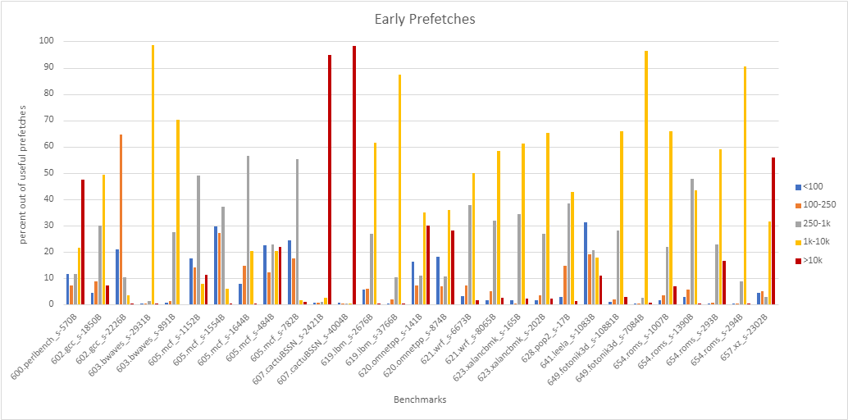
Early prefetches for L1D(IPCP)
cycles

Slide 56
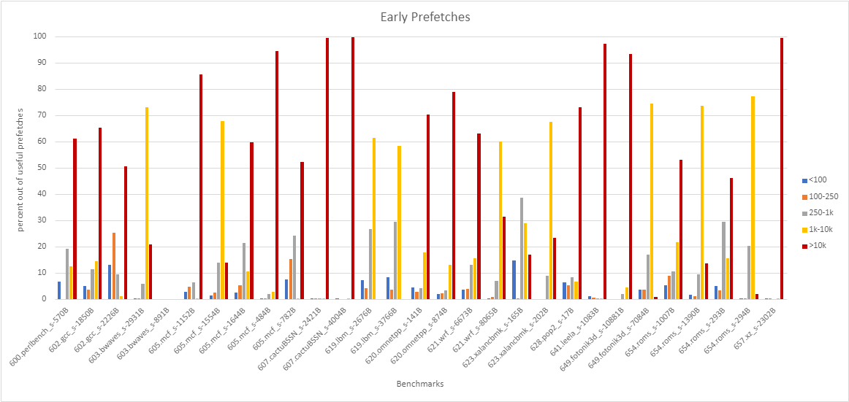
Early prefetches for L2C(IPCP)
cycles

Slide 57
Inference
In case of L1D, a significant percentage(44%) of early prefetches are early by 1k-10k cycles.
In case of L2C, a significant percentage(51%) of early prefetches are early by more than 10k cycles.
There is scope for improvement here to make the prefetches more timely.

Slide 58
CASPER @ IIT Bombay
RnD Weekly Discussion
Week of September 9, 2021
Sumon Nath sumon@cse.iitb.ac.in

Slide 59
Work done
Read about SPEC CPU benchmarks.
Automated the output generation process.
Analysis of late prefetches by IPCP.
Plots -> https://drive.google.com/drive/folders/10gR746t5V1JkrV5u4FtjkV8EUQsitohQ?usp=sharing

Slide 60

Benchmarks, some key pointers
Good benchmarks?
Is concerned with a specific workload
Produces a metric (time/throughput…) which is reproducible
Results are comparable when run on different systems
Should be portable
Checks for correctness of output

Slide 61
Benchmarks, some key pointers (SCPE CPU 2017)
Which benchmarks should I use?
Should measure the things that are important to our application.
Base vs peak
Base - benchmarks of suite must use a common set of optimization (standard)
Peak - can use different optimizations for each benchmark
SPECspeed vs SPECrate
SPECspeed - time-based metric
SPECrate - throughput metric

Slide 62
Some Benchmarks (SPEC CPU 2017)
600.perlbench - cut-down version of Perl scripting language
Components - spam checking software, email-to-HTML converter
602.gcc - runs gcc with many of its optimization flags enabled
605.mcf - program used for single-depot vehicle scheduling in public mass transportation and can be formulated as a large-scale minimum-cost flow problem
623.xalancbmk - XML to HTML converter
607.cactuBSSN - application for physics(relativity)
619.lbm - fluid dynamics
just for my reference

Slide 63
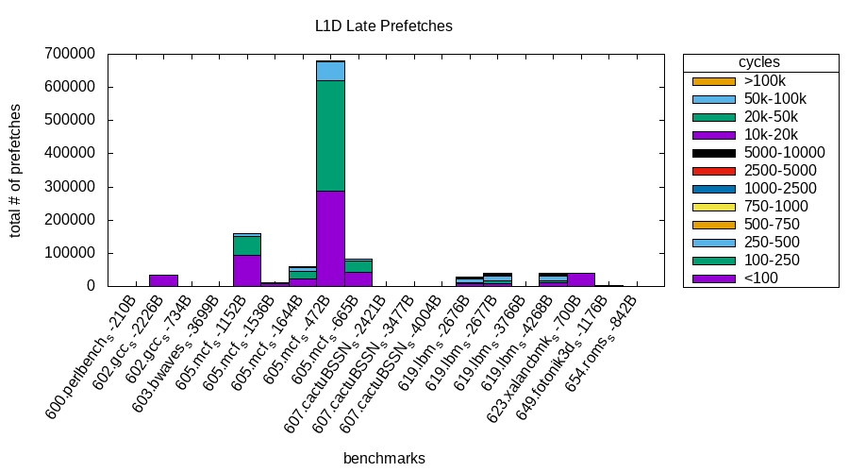
Late prefetches(IPCP, L1D)

Slide 64
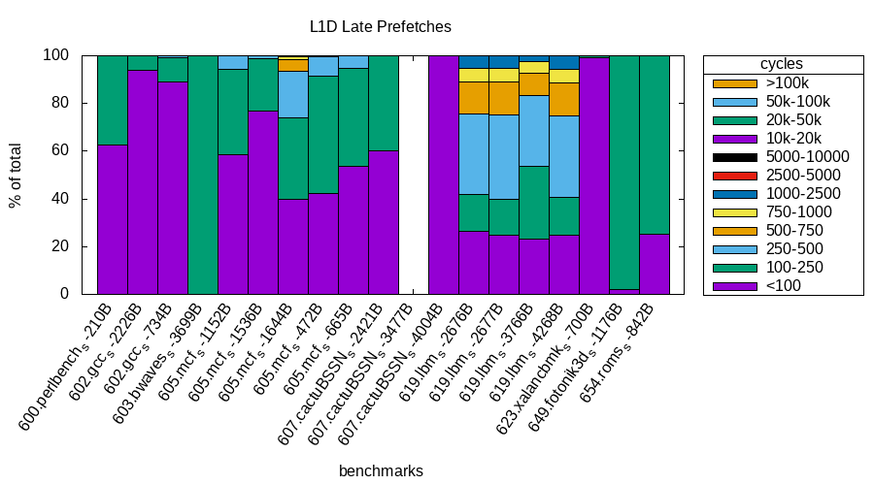
Late prefetches(IPCP, L1D)

Slide 65
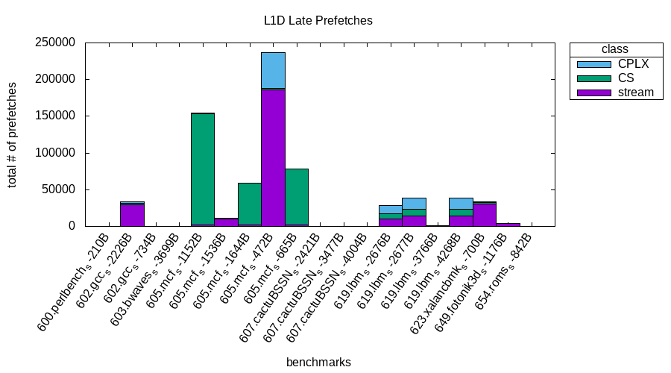
Late prefetches by class(IPCP, L1D)

Slide 66
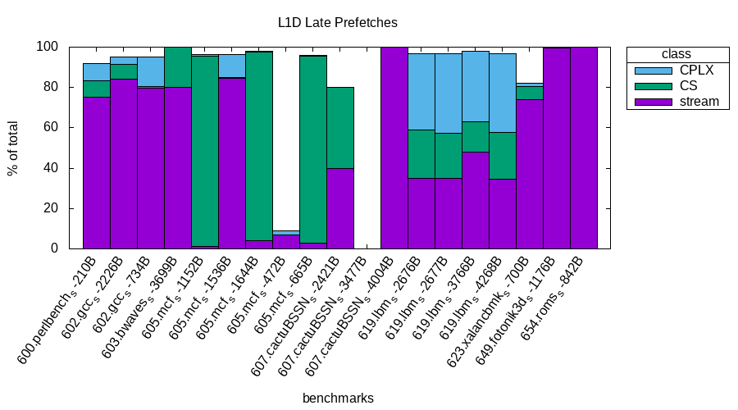
Late prefetches by class(IPCP, L1D)
* I forgot to the show the late prefetches associated with the NL class, that’s why the white spaces.

Slide 67
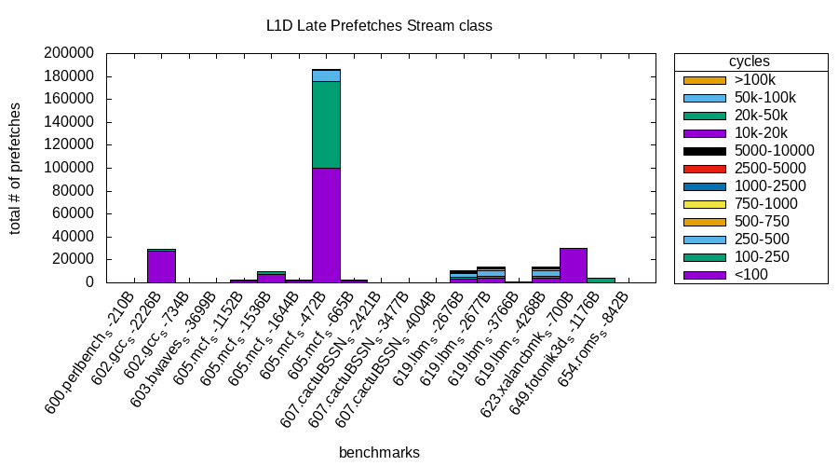
Late prefetches by stream class(IPCP, L1D)

Slide 68
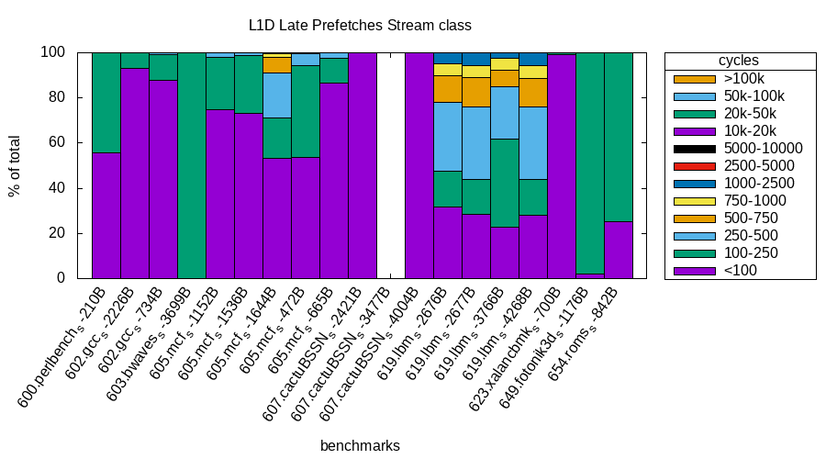
Late prefetches by stream class(IPCP, L1D)

Slide 69
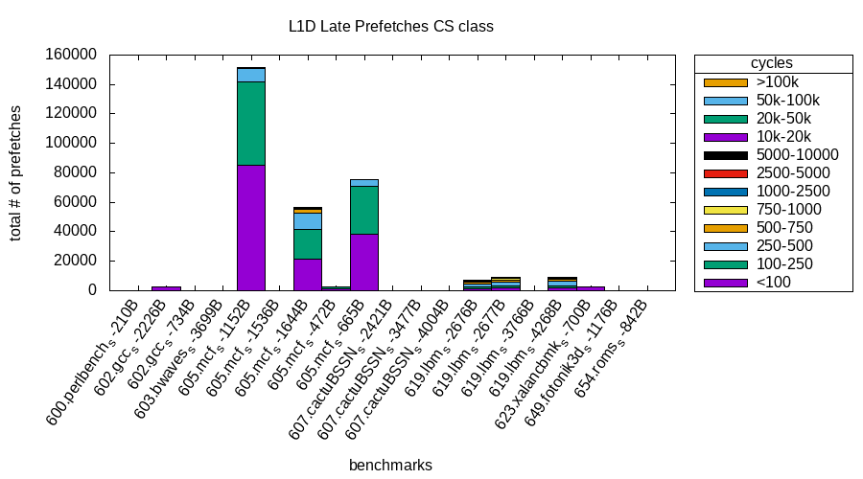
Late prefetches by CS class(IPCP, L1D)

Slide 70
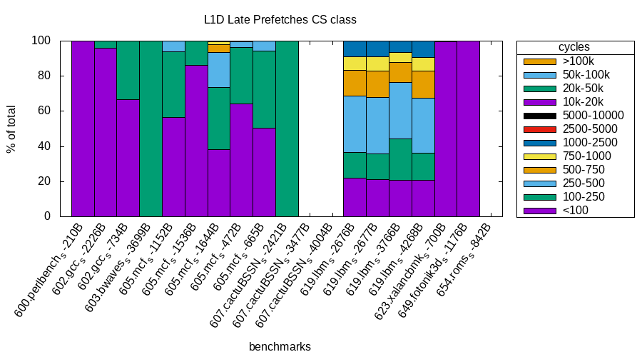
Late prefetches by CS class(IPCP, L1D)

Slide 71
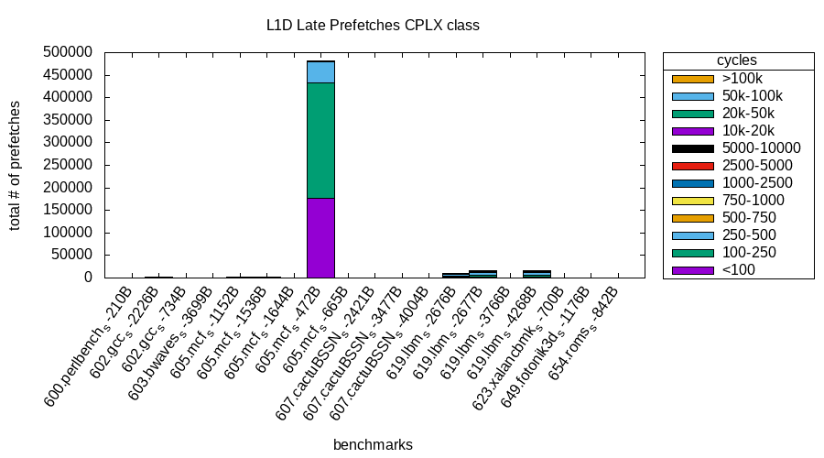
Late prefetches by CPLX class(IPCP, L1D)

Slide 72
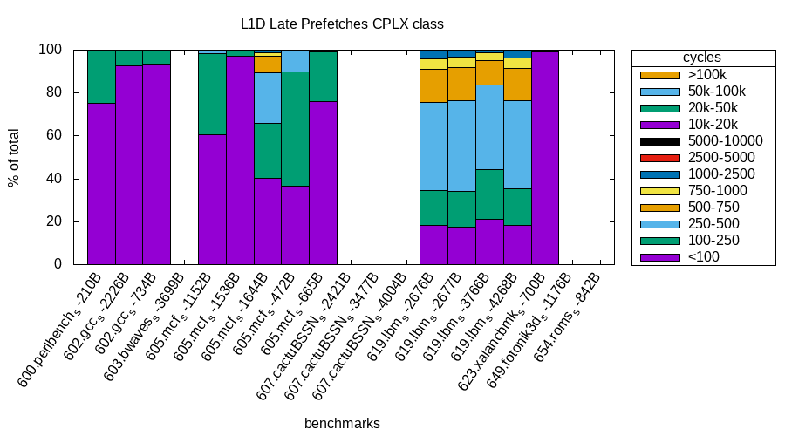
Late prefetches by CPLX class(IPCP, L1D)

Slide 73
Inference on lateness of L1D prefetches(IPCP)
Most of the late prefetches come from the stream(GS) class.(approx. 60%)
But most of the prefetches by stream class are not late by more than 100 cycles, except for a few benchmarks(lbm).
CS and CPLX class gets lesser percentage of late prefetches compared to stream class, but majority of the late prefetches are late by more than 100 and goes up to 2500 cycles.

Slide 74
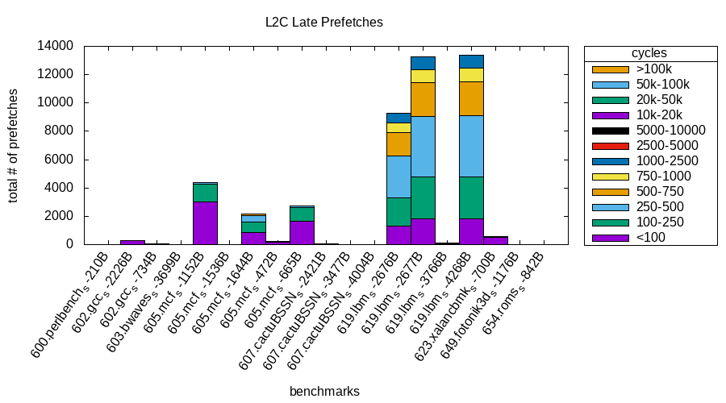
Late prefetches(IPCP, L2C)

Slide 75
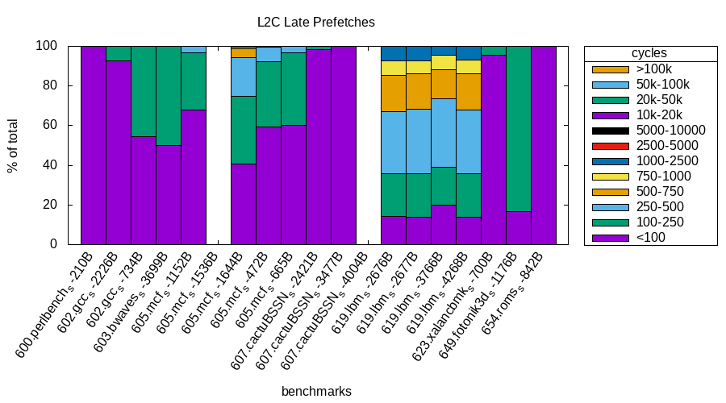
Late prefetches(IPCP, L2C)

Slide 76
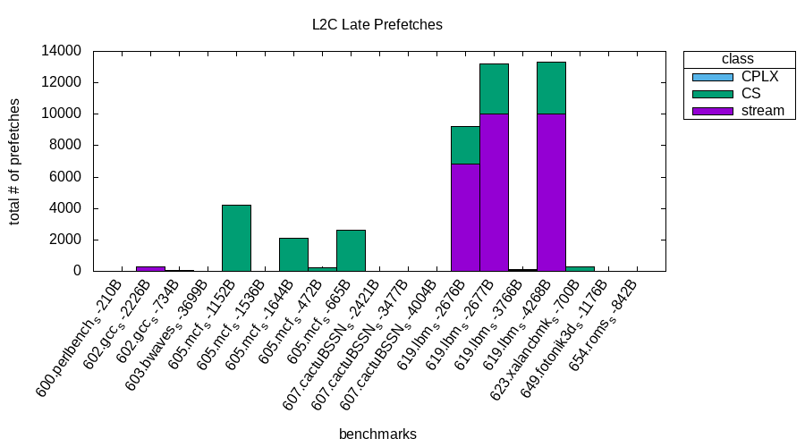
Late prefetches by class(IPCP, L2C)

Slide 77
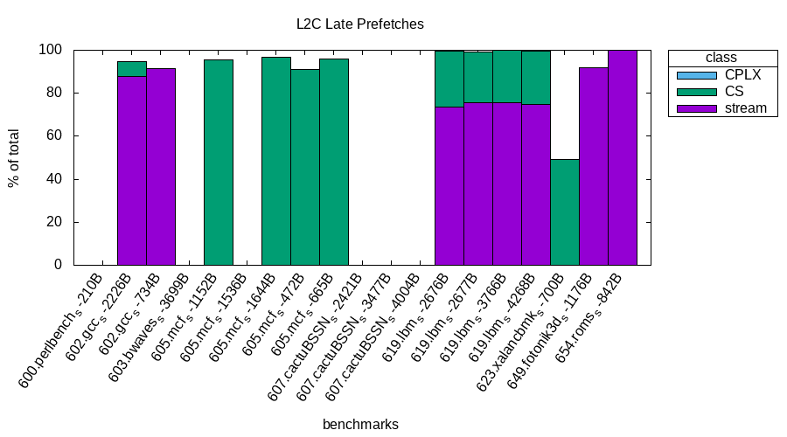
Late prefetches by class(IPCP, L2C)
* I forgot to the show the late prefetches associated with the NL class, that’s why the white spaces.

Slide 78
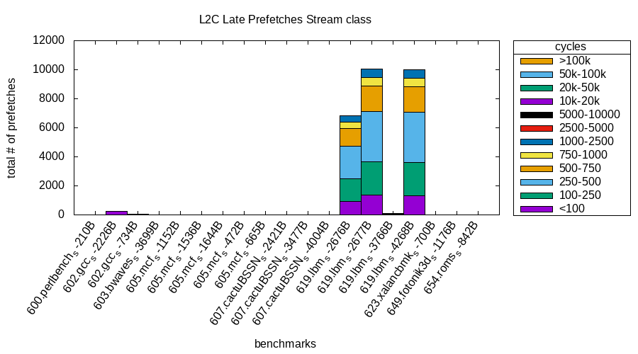
Late prefetches by stream class(IPCP, L2C)

Slide 79
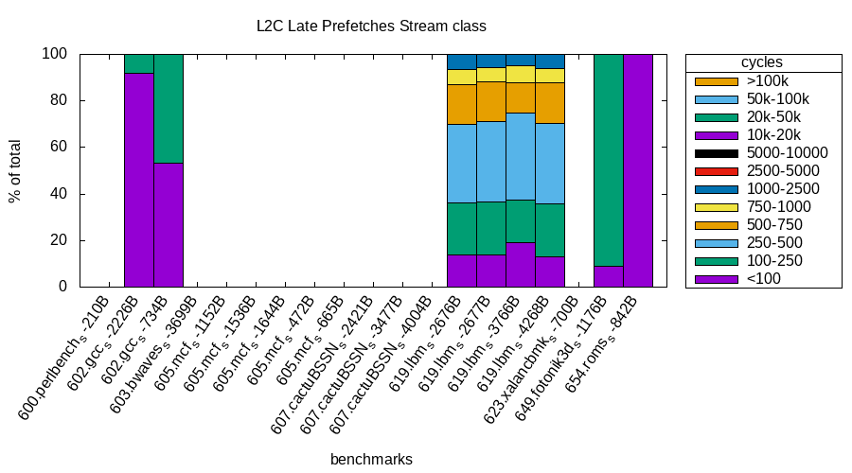
Late prefetches by stream class(IPCP, L2C)

Slide 80
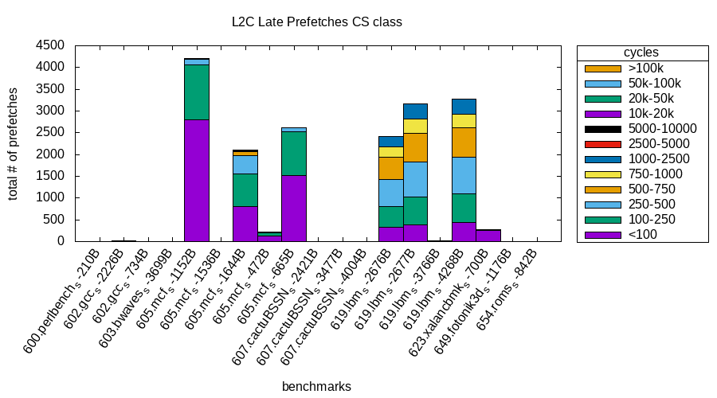
Late prefetches by CS class(IPCP, L2C)

Slide 81
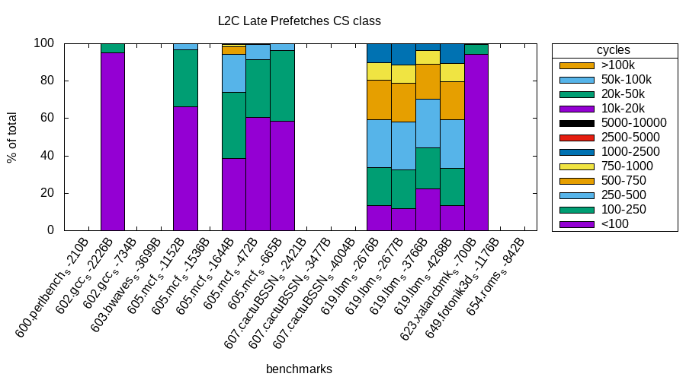
Late prefetches by CS class(IPCP, L2C)

Slide 82
Late prefetches by CPLX class(IPCP, L2C)
No late prefetches for CPLX class!

Slide 83
Inference on lateness of L2C prefetches(IPCP)
Similar trends to L1D prefetcher in terms of class wise distribution. Majority of the late prefetches comes from the stream class.
Unlike the case of L1D, prefetches are late by more than 100 cycles extending to 2500 cycles for both stream and CS class.

Slide 84
A small problem
The total number of prefetches in my measurements were off by a bit compared to the numbers produced by code written by Vishal/Neelu. Maybe I they removed the prefetches which were dropped from the total prefetches.

Slide 85
What next
Analysis of the early prefetches (plots are ready).
Start thinking about mechanisms to improve timeliness of IPCP (emphasize more on stream class, as it is the common case).I am a bit confused here!

Slide 86
CASPER @ IIT Bombay
RnD Weekly Discussion
Week of August 31, 2021
Sumon Nath sumon@cse.iitb.ac.in

Slide 87
Work done
Found the number of early and late prefetches, and by how many cycles they are early and late respectively.
Discussions with Pratik, Debashish, Prashant.

Slide 88
Data of experiments(IPCP)
https://docs.google.com/spreadsheets/d/1o6GxowF6S_2gUZHxSpDft7pVXSP03-hC1a14gxnwCPs/edit?usp=sharing

Slide 89
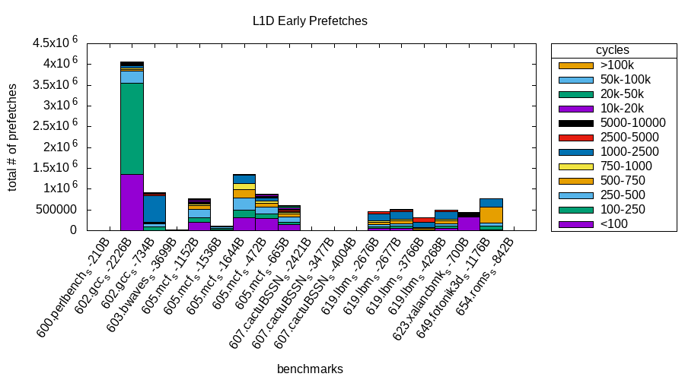
Results of experiment(IPCP)

Slide 90
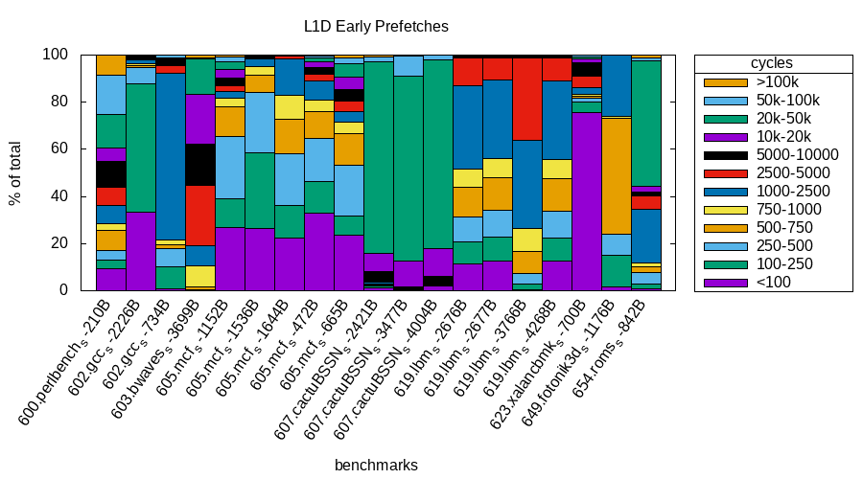
continued...

Slide 91
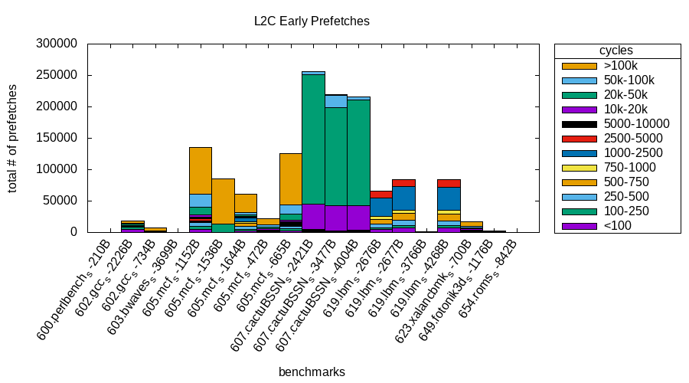
continued...

Slide 92
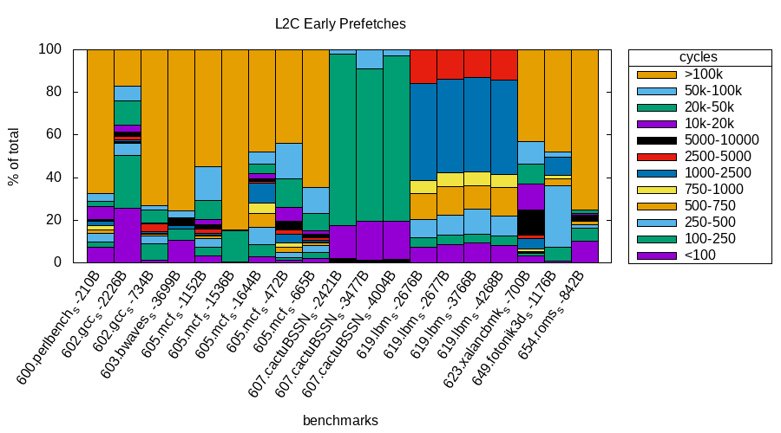
continued...

Slide 93
continued...

Slide 94
continued...

Slide 95
continued...

Slide 96
That’s it!

Slide 97
CASPER @ IIT Bombay
RnD Weekly Discussion
Week of 24th August, 2021
Sumon Nath sumon@cse.iitb.ac.in

Slide 98
Work done
Discussion with Prashant regarding working of prefetch queue and writeback.
Brushed up the concepts of IPCP.
Went through the code of IPCP.

Slide 99
What next?
Start with some implementation.

Slide 100
CASPER @ IIT Bombay
RnD Weekly Discussion
Week of 17th August, 2021
Sumon Nath sumon@cse.iitb.ac.in

Slide 101
Work done
Discussion with Pratik regarding RFO, store queue.
Went through the remaining part of cache.cc
Made flowchart of handle_writeback

Slide 102
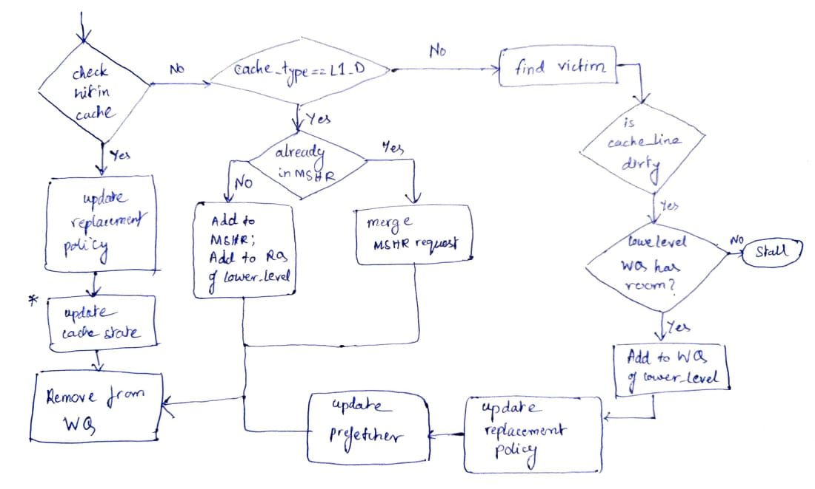
Flow of handle_writeback()
Fig. 1 handle_writeback
flowchart

Slide 103
Questions/Doubts
In hande_writeback, why is there no eviction in case of L1_D?

Slide 104
CASPER @ IIT Bombay
RnD Weekly Discussion
Week of 10th August, 2021
Sumon Nath sumon@cse.iitb.ac.in

Slide 105
Work done/Week Summary
Read the code that handles cache operations in the Champsim simulator.
Made flow diagrams of functions which handles reads and fills in cache.

Slide 106
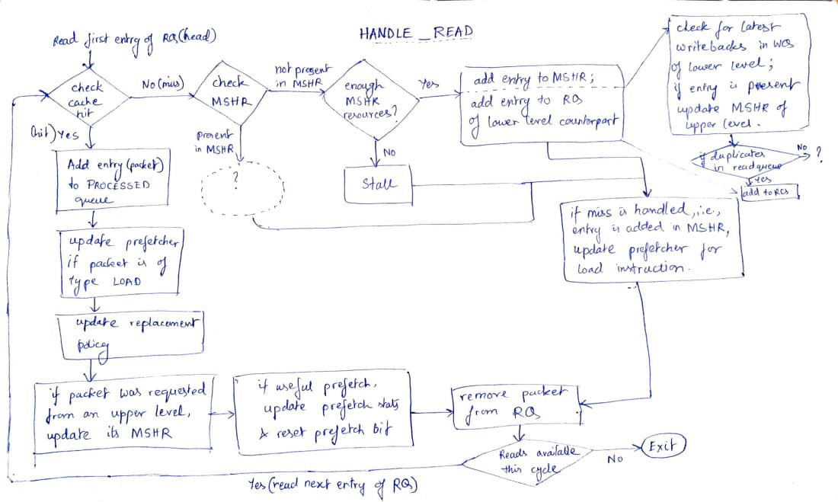
Flow of handle_read()
Fig. 1 handle_read
flowchart

Slide 107
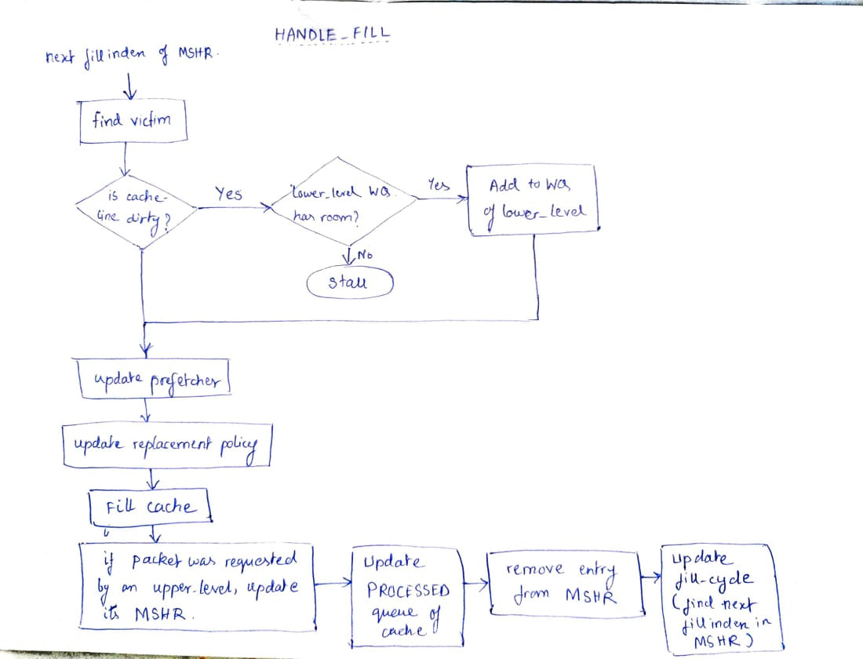
Flow of handle_fill()
Fig. 2 handle_fill
flowchart

